Slide 1

Home
Special
Order
Account
Comment
CHOC O LAT

Slide 2
https://youtu.be/VvJm4pQZ04s

Slide 3
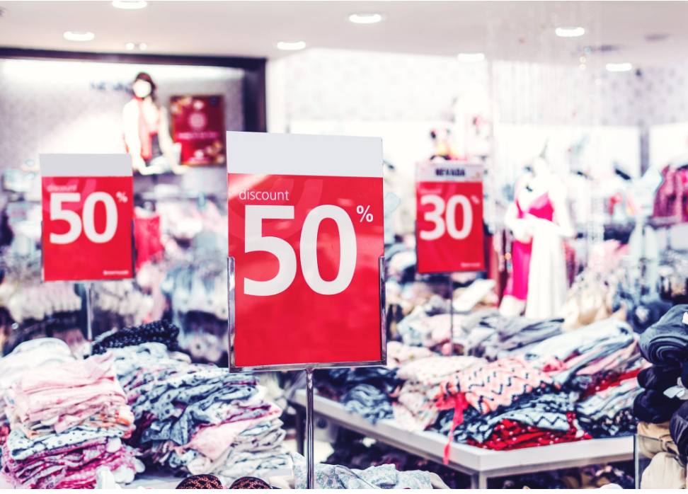
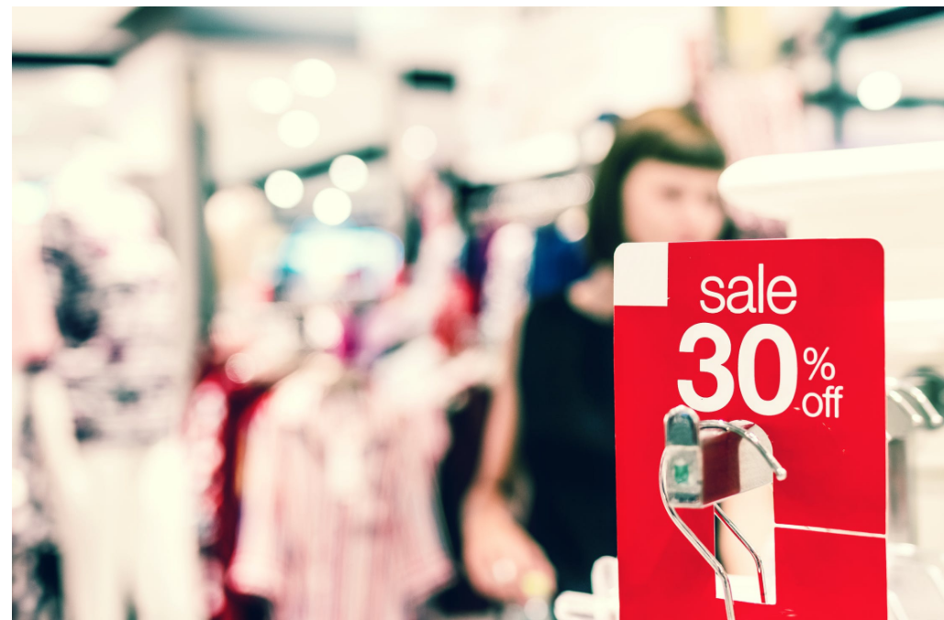
In our company when the costumer has got many access and it has started to get a lot of order, he start to receive discount offerts from us. In this case he will be able to accumulate points and get a gift, every time that he use the discount he gets 5 points, or when he is advising the website to someone he gets 7 points.
Discount for costumer
The offer can also be used in our related company and store, as fast food or computer store which they provide a new offerts as well.

Slide 4
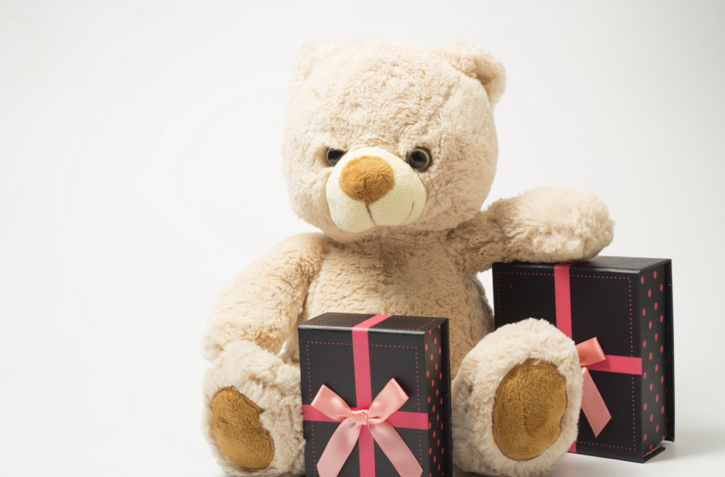
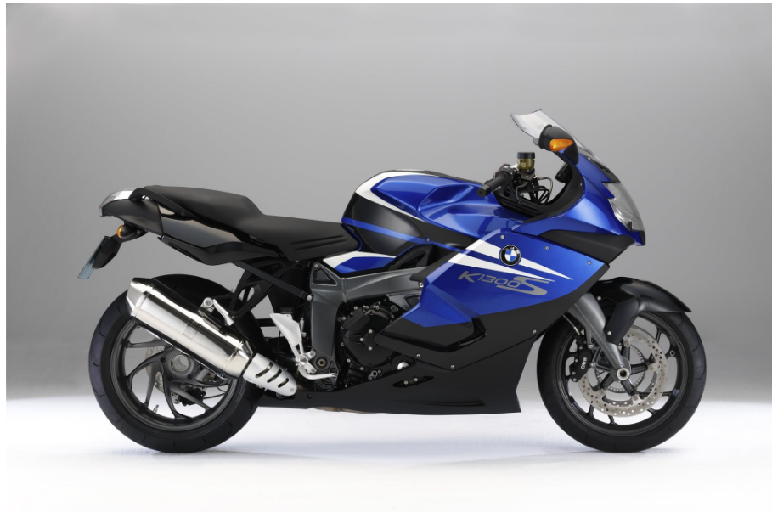
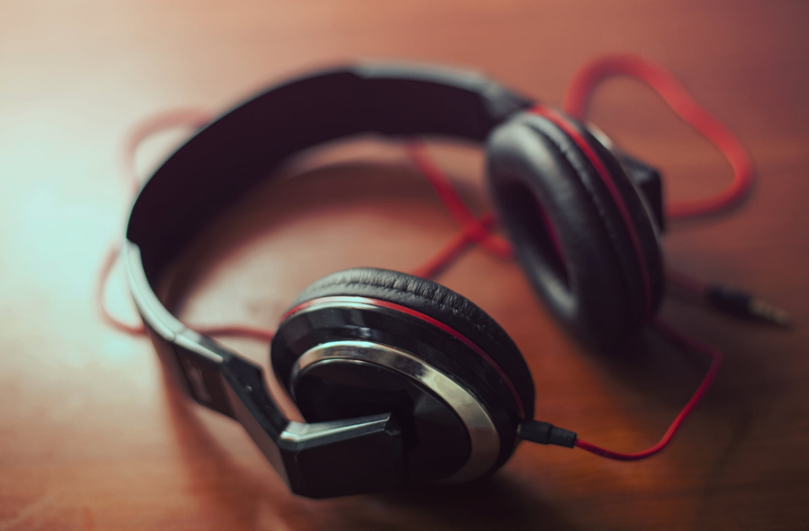
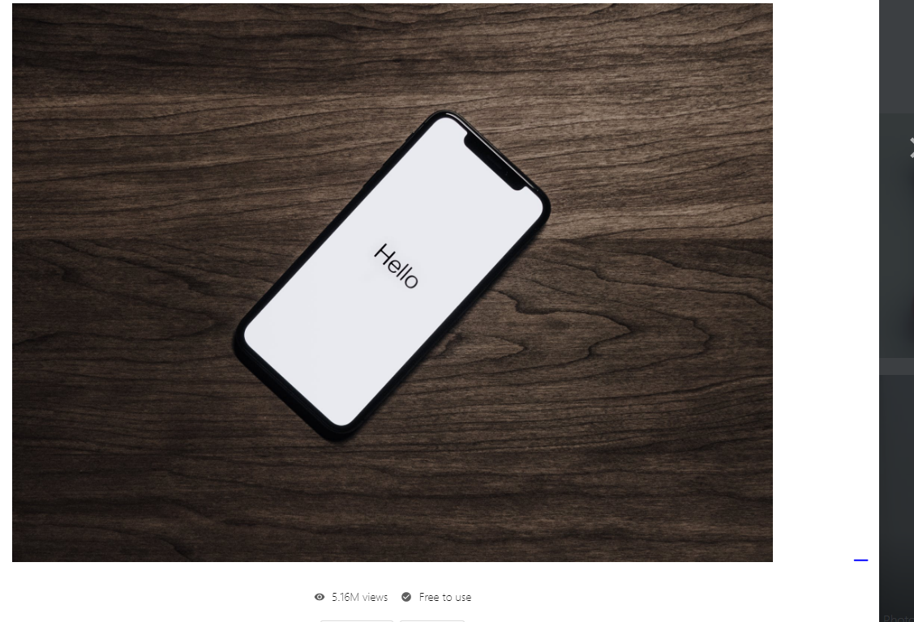
Those are the main gifts that we provide for our costumer that have took longer with us.
F
O
R
C
O
S
T
U
M
E
R
G
I
F
T
S
Slideshow
The beards can be got with 30 points
The headphone can be got with 500 points
The motorcycle can be got with 1000 points
The phone can be got with 5000 points

Slide 5


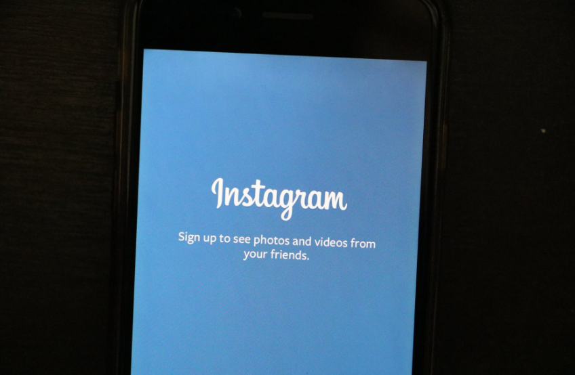
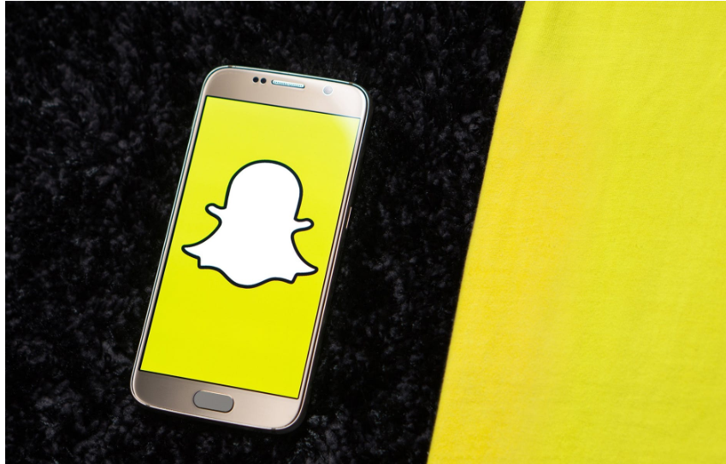

Email: cholatetaste@gmail.com
Address:Ashton Underlyne M11 27W
Telephone: 07451864828

